Slide 1
Sprint Review R2.2
Carriage team
09 Oct 2018

Slide 2
Sprint Goal –Creation of Duty Deferment Account
Summary of completed work in Sprint 2.2
Feature CDSP-3308 (Creation of Duty Deferment Account)
http://10.102.81.252/browse/CDSP-3308
Due to the issue regarding the delivery of finance within ETMP for the early CDS releases, a business decision was made to continue the use of DDS for the management of duty deferment. The CDS strategic processes for creation and management of duty deferment accounts require the explicit presence of ETMP as primary host to those accounts.
For CDS Release 2, due to the decision to remain on legacy finance and the potential increase in volume of accounts which must be mirrored within SPS, there is a requirement to provide a duty deferment creation & management solution which will be more capable of dealing with that increase in volume, mitigating the impact to the business and the trade of continuing with the tactical solution.
This will be out of process (legacy finance system: CECAS), and the DAN will be manually entered into the Registration Case Management system (RCM) which will send the message directly to SPS. SPS will specifically not record bank details. If they are sent they can be silently ignored and not recorded. In addition to creating the deferment account number (which will now be manually entered) ETMP also generates guarantee account numbers (GAN) which will now be generated by SPS (in Release 2)

Slide 3
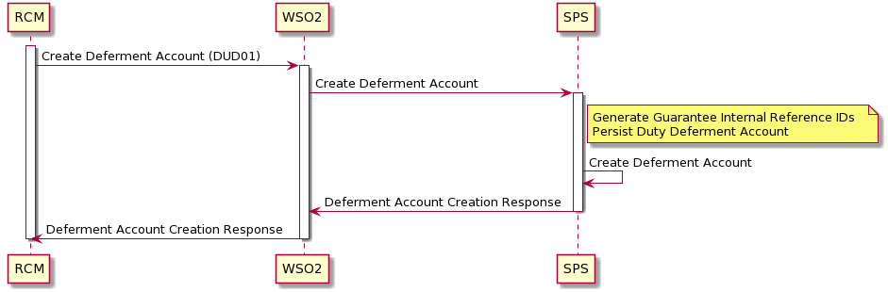
Overall Process View

Slide 4
Sprint Goal –LiSCA to copy and send SPIRE License update (inbound) file to ILMS + Acknowledgement
Summary of completed work in Sprint 2.2
Feature CDSP-3218 (Creation of Duty Deferment Account)
http://10.102.81.252/browse/CDSP-3324
License SPIRE update (Inbound files)
LiSCA copies SPIRE update file
LiSCA copy of SPIRE export update (inbound) file received in MDG S3 Bucket AWS
SPIRE export update (inbound) file from MDG S3 Bucket AWS is received in ILMS
Errors generated and sent to ELK Ops if unsuccessful receipt/sending of files
Error generated and sent to ELK Ops if copy generation of files is unsuccessful
License SPIRE update acknowledgement files (ILMS to DIT (SPIRE))
SPIRE export license update acknowledgement from ILMS is received in MDG S3 Bucket AWS
LiSCA pulls SPIRE export license update acknowledgement from MDG S3 Bucket AWS
Errors generated and sent to ELK Ops if unsuccessful receipt of files
Acknowledgement comparison
LiSCA compares acknowledgement file from CHIEF with acknowledgement from ILMS
For any discrepancies found appropriate measures/flags are taken

Slide 5
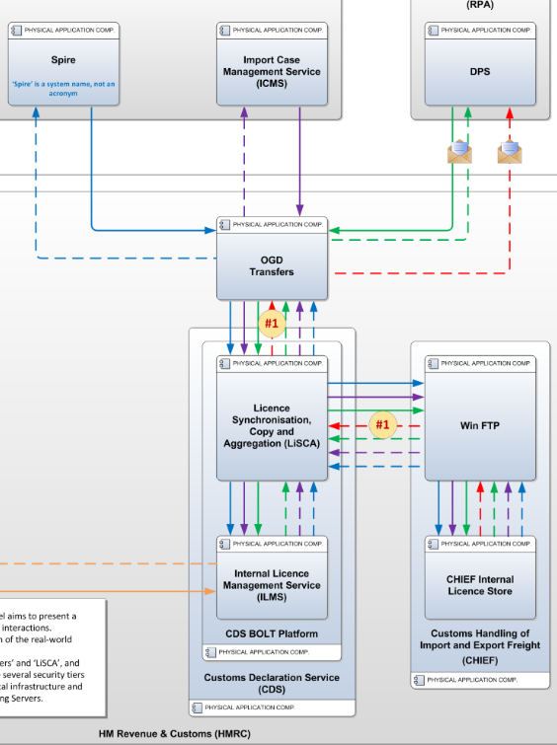
Overall Process View

